Slide 1
Monte Carlo simulations for Protein Folding
Anirudh Ghantasala

Slide 2
Conventional Protein Folding – Molecular Dynamics
MD is a way to model a system of particles.
“The very essence of MD, simply, is to solve numerically the N-body problem of classical mechanics…” – Shekaari et al.
Summary
Initialize a system : pos, vel, accelerations
Assign a potential energy to each atom
Derive forces from potential energy
Shift particles one timestep forward
U_{ab}
∂
x_{b}
F_{ab} =
-
∂x
x_{a}

Slide 3
Monte Carlo approach to Molecular Dynamics
Initialize a system : positions, velocities, accelerations
x_{b}
x_{a}

Slide 4
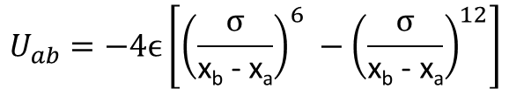
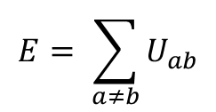
Monte Carlo approach to Molecular Dynamics
Initialize a system : x, v, a
Assign a potential energy to each atom
$$U_{ab}=−4ϵ\left[{\left(\frac{σ}{\text{x}\text{b}\text{ − }\text{xa}}\right)}^{6} −{\left(\frac{σ}{\text{x}\text{b}\text{ − }\text{xa}}\right)}^{12}\right]$$
$$E= \sum_{a≠b}{U_{ab}}$$
x_{b}
U_{ab}
x_{a}

Slide 5
Monte Carlo approach to Molecular Dynamics
Initialize a system : x, v, a
Assign a potential energy to each atom and find E_{state}
3. Propose a new state according to some proposal distribution
Gaussian Proposal
b
a

Slide 6


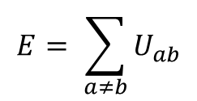
Monte Carlo approach to Molecular Dynamics
Initialize a system : x, v, a
Assign a potential energy to each atom and find total Energy
Propose a new state
Find total energy for new state
$$E= \sum_{a≠b}{U_{ab}}$$
$$E$$
$$E_{proposal}$$
b
a

Slide 7

Monte Carlo approach to Molecular Dynamics
Initialize a system : x, v, a
Assign a potential energy to each atom and find total Energy
Propose a new state
Find total energy for new state
Accept or reject the new proposal according to Metropolis-Hastings:
$$P_{accept}( proposal , current)$$
$$E$$
$$E_{proposal}$$
b
a

Slide 8
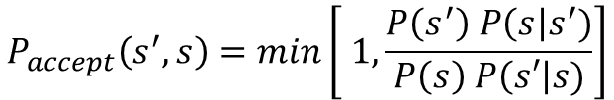
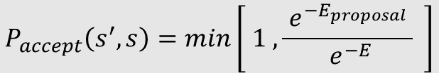
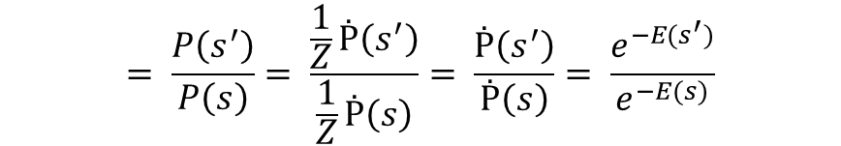
P_{accept}
$$P_{accept}\left(s^{′},s\right)=min\left[ 1, \frac{P\left(s^{′}\right) P\left(s\right|s^{′})}{P\left(s\right) P\left(s′\right|s)}\right]$$
Gaussian Proposal is isometric
$$= \frac{P\left(s^{′}\right)}{P\left(s\right)}= \frac{\frac{1}{Z}Ṗ\left(s^{′}\right)}{\frac{1}{Z}Ṗ\left(s\right)}= \frac{Ṗ\left(s^{′}\right)}{Ṗ\left(s\right)}= \frac{e^{−E(s^{′})}}{e^{−E(s)}}$$
$$P_{accept}\left(s^{′},s\right)=min\left[ 1 , \frac{{ e}^{−E_{proposal}} }{{ e}^{−E}} \right]$$

Slide 9

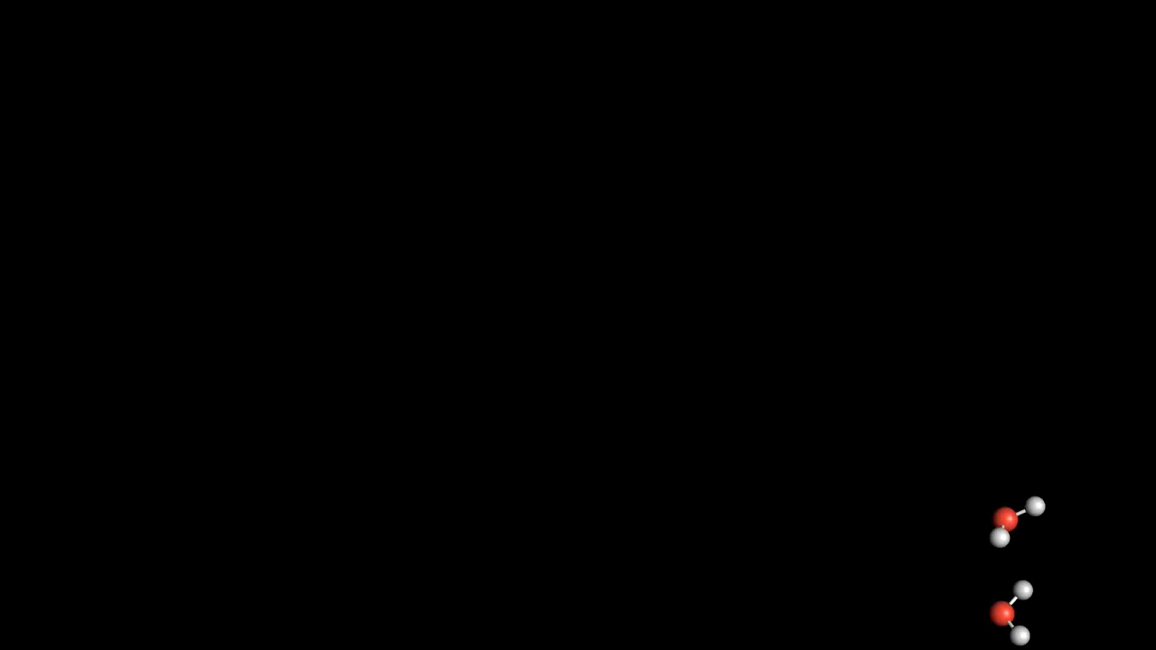
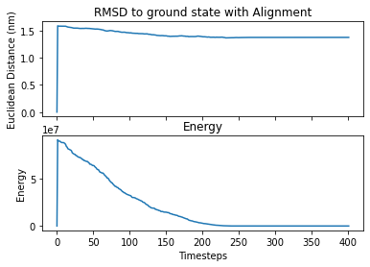
Simulation of H₂O Molecule
1. Original
Repeatedly propose new positions and accept them following a metropolis criterion
2. Add noise
1
nm
2
nm
nm
0
Final dihedral bond angle: 104.02º

Slide 10
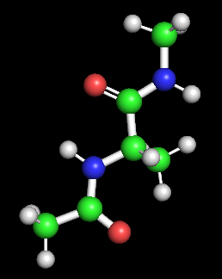
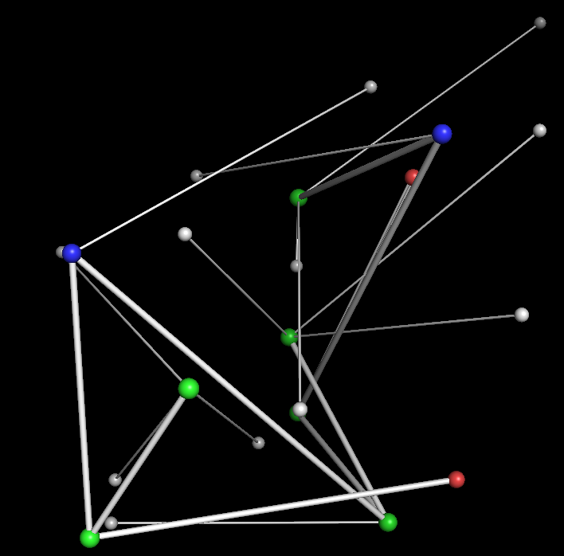
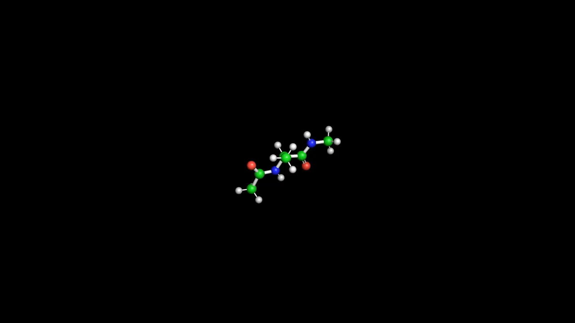
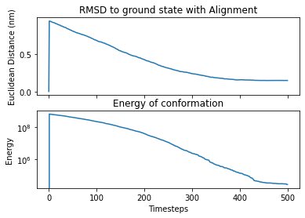
Simulation of Alanine Dipeptide – Tight proposal
1. Original
2. Add noise
3. Repeatedly propose new positions and accept them following a metropolis criterion

Slide 11
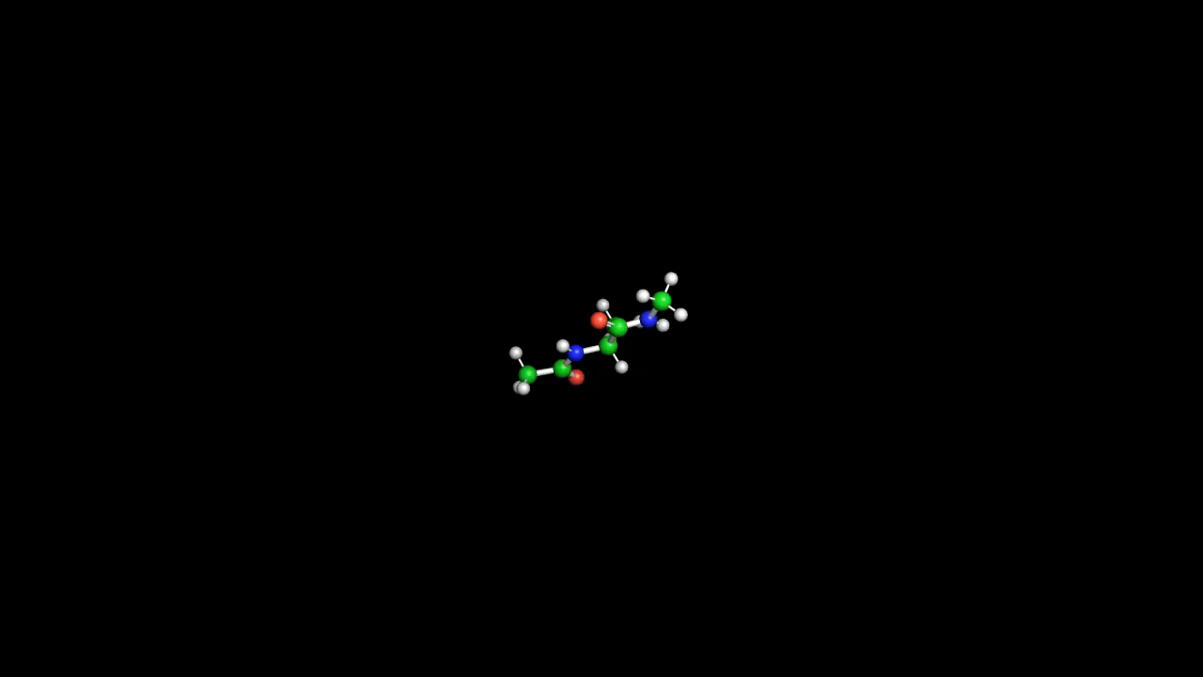
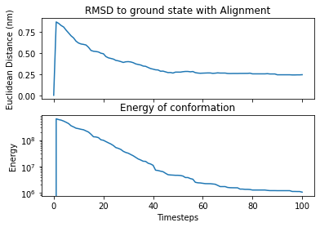
Simulation of Alanine Dipeptide – Loose proposal
1. Original
2. Add noise
3. Repeatedly propose new positions and accept them following a metropolis criterion

